Slide 1
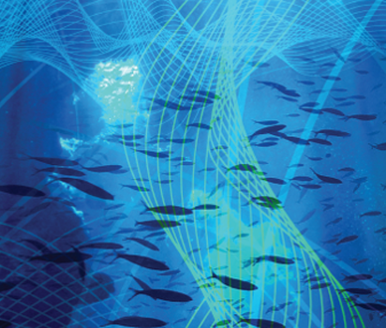
#UKANResearchSoundings - Repeat Pass Synthetic Aperture Sonar Bathymetry Estimation Ben Thomas Repeat-pass synthetic aperture sonar bathymetry estimation is a technique for acoustic 3D seafloor mapping with ultra-high vertical precision. The method involves traversing repeated tracks past a scene with an autonomous underwater vehicle at varying depths, generating a high resolution seafloor image from each pass. The phase difference between each pair of images contains information about the depth of the seafloor. Fusing the phase differences between all passes increases the precision of the seafloor depth estimates. This is similar to how our ears are used to estimate the direction of an acoustic source, by measuring the phase difference between the signals arriving at each ear. This audio clip contains a moving acoustic source, whose path repeats when each note is added. Each note represents an additional pass, giving extra information about the direction of the source. The path of the source is easier to discern as the number of notes increases.
Special Interest Group
for Underwater Acoustics

