Slide 1
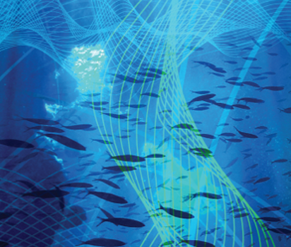
#UKANResearchSoundings - Wideband Acoustic Echoes from an Underwater Pipe Alan Hunter Wideband acoustic signals can be used to ping underwater objects and listen to their echoes. This is useful for detecting and characterising objects of interest in the water column or on/beneath the seafloor. The audio clip contains a sequence of echoes from a truncated aluminium pipe (300mm diameter x 600mm length x 12.5mm wall thickness). Each echo is observed from a different angle, starting from a direction that is perpendicular to the pipe wall and then rotating towards its end. The frequency content of the sound changes with the observation angle. This dependence in frequency and angle provides useful classification features that relate to the object’s structure and composition. The sounds have been slowed down so that the frequencies are shifted into the lower audible part of the acoustic spectrum. This creates a more pleasing sound for listening.
Special Interest Group
for Underwater Acoustics

